Slide 1


Functional programming in concurrent and distributed systems
381-1-0112 | SM B 2018 | Tutorial 4
David Leon

Slide 2
Outline
Erlang types
Success typing
Type
Spec
Dialyzer
Example
Higher-Order Functions
Submission procedures

Slide 3
#1 Erlang Types
Built-in type | Defined as
term() | any()
binary() | <<_:_*8>>
bitstring() | <<_:_*1>>
boolean() | 'false' | 'true'
byte() | 0..255
char() | 0..16#10ffff
number() | integer() | float()
list() | [any()]
maybe_improper_list() | maybe_improper_list(any(), any())
nonempty_list() | nonempty_list(any())
string() | [char()]
nonempty_string() | [char(),...]
iodata() | iolist() | binary()
iolist() | maybe_improper_list(byte() | binary() | iolist(), binary() | [])
module() | atom()
mfa() | {atom(),atom(),arity()}
arity() | 0..255
node() | atom()
timeout() | 'infinity' | non_neg_integer()
no_return() | none()

Slide 4
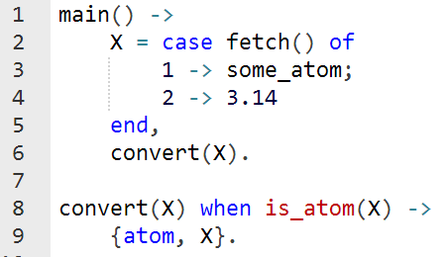
#1.1 Success Typing
Erlang programs are always at risk of suffering from type errors
Is there a problem in the following code?
Think what may happen if fetch/0 returns 2

Slide 5
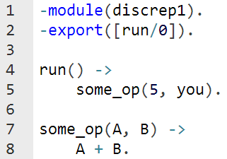
#1.1 Success Typing
Erlang programs are always at risk of suffering from type errors
Is there a problem in the following code?
Think if you can
add 5 to you

Slide 6
#1.2 Types
It’s possible to define a new type:
Examples:

Slide 7
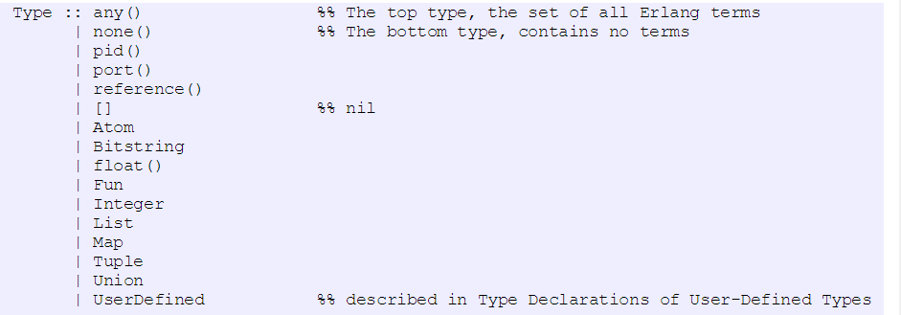
#1.2 Erlang Pre-defined Types

Slide 8
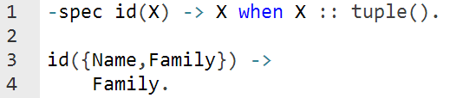
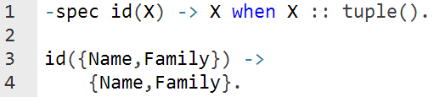

#1.4 Specs
A spec of a function is given using the compiler attribute '-spec‘
The general format is as follows:
Example:

Slide 9
#2 Dialyzer
Dialyzer is a tool to analyze Erlang code
Definite type errors
Dead/unreachable code
Unnecessary tests, etc.
Uses Persistent Lookup Table (PLT)
A compilation of all the details Dialyzer can identify about your
Applications
Modules
OTP, etc.
PLT needs to be built once when starting to use Dialyzer using the command:
Dialyzer starts its analysis from either debug-compiled BEAM bytecode or from Erlang source code.

Slide 10
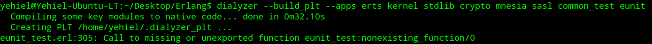
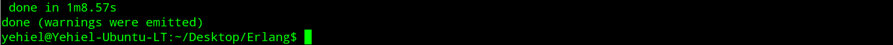
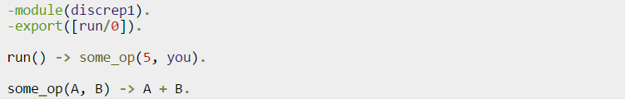
#2 Dialyzer
Building the PLT
Ignore the warnings; Dialyzer can look for type errors with unknown functions
Example module
To be downloaded from the course site in Moodle (discrep1.erl)
Analyze the module using Dialyzer

Slide 11
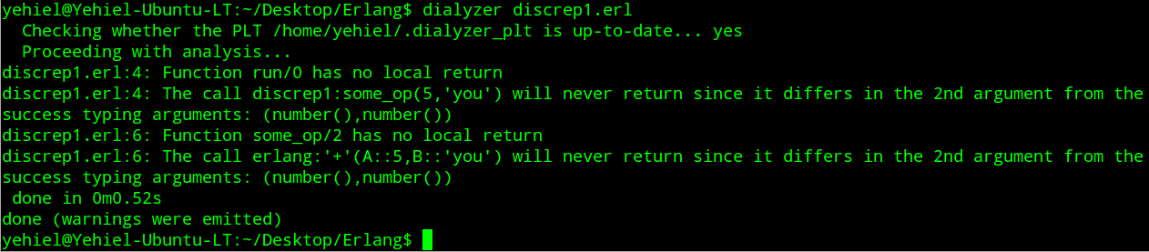
#2 Dialyzer
The output:
Example module
Notes:
ההערה על חזרה מקומית – שגרתית וקורית כל הזמן, מכיוון שמחזירים ערך של פונקציה ולא משהו מוגדר היטב.

Slide 12
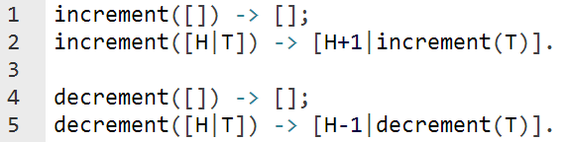
#3 Higher-Order Functions
We may be interested in writing functions that work recursively over the elements of a list
Add or subtract 1 from each element in a list of integers
Check conditions and return a proper result for each element
There is a better solution for this kind of usage!

Slide 13
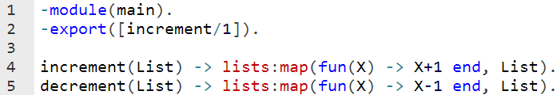
#3 Higher-Order Functions
Using map/2 is more efficient, and is more safe to use
Note that this implementation handles empty lists properly

Slide 14
#4 Submission Procedures
Only a single .erl file to be submitted
Filename format: ex4_<ID>.erl
Where <ID> needs to be replaced with your ID number
Your code MUST be well documented
Functions’ names must be identical to the ones defined in exercise
Same as for the arity
Same as for the output format
Only the tested functions needs to be exported
Internal functions MUST NOT be exported
Assignments will be tested automatically in using Erlang shell in Linux
No excuses

Slide 15
Exercise 4
flatten(List)
Returns a flat List
Examples
flatten([[1,[2,[3],[]]], [[[4]]], [5,6]]) → [1,2,3,4,5,6].
flatten([]) → [].
smaller(List, Thr)
Returns a list of true/false atoms according to elements that are smaller or equal to Thr.
Must use lists:map
Examples
smaller([1,2,3,4,5,2], 3) → [true,true,true,false,false,true].
smaller([],2) → [].

Slide 16
Exercise 4
replace(List, Old, New)
Replaces all instances of Old with New in List
Examples
replace([1,2,3,4,3], 3,0) → [1,2,0,4,0].
replace([1,q,2,w,3,e,1.0],1,[]) → [[],q,2,w,3,e,1.0].
mapSub(List1,Arg2)
Subtracts elements of List1 by Arg2
Must use lists:map
Examples
mapSub([1,2,3,4,5,1,2,3,4,5],[1,1,2]) → lenError
mapSub([1,2,3,4,5,1,2,3,4,5],[1,2,3,4,6,1,2,3,4,5]) → [0,0,0,0,-1,0,0,0,0,0]
mapSub([1,2,3,4,5,6,7,8,9],5) → [-4,-3,-2,-1,0,1,2,3,4]
mapSub([1,2,3,4,5],[]) → [1,2,3,4,5]
mapSub([],[]) → []
mapSub([],[1,2,3]) → lenError

